Slide 1
Clustering

Slide 2
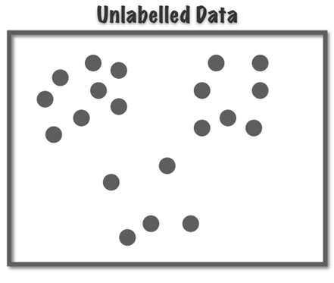
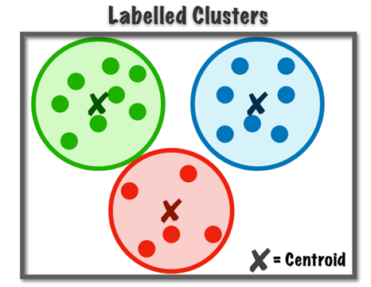

Clustering
Clustering is a unsupervised machine learning technique used to group similar data points together based on certain characteristics.
It’s an unsupervised method, meaning it doesn’t rely on labeled data. Instead, it identifies patterns within the data to form clusters or groups.
Example:

Slide 3
Clustering Algorithm
K-Means Clustering
K-Medoid
EM-Clustering
DBSCAN
SLINK

Slide 4
Metric to Evaluate clustering
Inertia (Within-Cluster Sum of Squares Error)
Silhouette Score
Dunn Index
BETA CV
Davies-Bouldin Index

Slide 5
K-Means Clustering
You are given the following items {2,4,10,12,3,20,30,11,25}. Find the number of clusters and its datasets for K = 2 & K=3 by using metric SSE to check which one is good.

Slide 6
Step-1: Find Initial Centroid m1 = 2
m2 = 4
C1 = { 2,3}
C2 = {4,10,12,20,30,11,25}
Step-2:
m1 = Avg (2,3) = 2.5
m2 = Avg (4,10,12,20,30,11,25) = 16
C1 = { 2,4,3 }
C2 = {10,12,20,30,11,25}
Step-3:
m1 = Avg (2,4,3) = 3
m2 = Avg (12,20,30,11,25) = 18
C1 = { 2,4,10,3}
C2 = {12,20,30,11,25}
Step-4:
m1 = Avg (2,4,10,3) = 4.75
m2 = Avg(12,20,30,11,25) = 19.6
C1 = { 2,4,10,12,3,11}
C2 = {20,30,25}
 | 2 | 4 | 10 | 12 | 3 | 20 | 30 | 11 | 25
d(x,m1) | 0 | 2 | 8 | 10 | 1 | 18 | 28 | 9 | 23
d(x,m2) | 2 | 0 | 6 | 8 | 1 | 16 | 26 | 7 | 21
Cluster | C1 | C2 | C2 | C2 | C1 | C2 | C2 | C2 | C2
 | 2 | 4 | 10 | 12 | 3 | 20 | 30 | 11 | 25
d(x,m1) | 1 | 1 | 7 | 9 | 0 | 17 | 27 | 8 | 22
d(x,m2) | 16 | 14 | 8 | 6 | 15 | 2 | 12 | 7 | 7
Cluster | C1 | C1 | C1 | C1 | C1 | C2 | C2 | C1 | C2
 | 2 | 4 | 10 | 12 | 3 | 20 | 30 | 11 | 25
d(x,m1) | 2.75 | 0.75 | 5.25 | 7.25 | 1.75 | 15.25 | 25.25 | 6.25 | 20.25
d(x,m2) | 17.6 | 15.6 | 9.6 | 7.6 | 16.6 | 0.40 | 10.4 | 8.6 | 5.4
Cluster | C1 | C1 | C1 | C1 | C1 | C2 | C2 | C1 | C2
 | 2 | 4 | 10 | 12 | 3 | 20 | 30 | 11 | 25
d(x,m1) | 0.5 | 1.5 | 7.5 | 9.5 | 0.5 | 17.5 | 27.5 | 8.5 | 22.5
d(x,m2) | 14 | 12 | 6 | 4 | 13 | 4 | 14 | 5 | 9
Cluster | C1 | C1 | C1 | C2 | C1 | C2 | C2 | C2 | C2

Slide 7
Step-4:
m1 = Avg (2,4,10,12,3,11) = 7
m2 = Avg(20,30,25) = 25
 | 2 | 4 | 10 | 12 | 3 | 20 | 30 | 11 | 25
d(x,m1) | 5 | 3 | 3 | 5 | 4 | 13 | 23 | 4 | 18
d(x,m2) | 23 | 21 | 15 | 13 | 22 | 5 | 5 | 14 | 0
Cluster | C1 | C1 | C1 | C1 | C1 | C2 | C2 | C1 | C2
C1 = { 2,4,10,12,3,11}
C2 = {20,30,25}

Slide 8

Calculation of Performance metric
Calculation of SSE:-
M1 =7 &, M2 =25
C1 = { 2, 3, 4, 10, 12, 11 }
C2 = {20, 30, 25 }
$\text{d}\text{(}\text{M}\text{1,}\text{C}\text{1)}= \sum{{(x−m_{1})}^{2}}$
$={(2−7)}^{2}+{(3−7)}^{2}$+${(4−7)}^{2}$+${(10−7)}^{2}$+${(12−7)}^{2}$+${(11−7)}^{2}$
$=100$
$\text{d}\text{(}\text{M}\text{1,}\text{C}\text{1)}= \sum{{(x−m_{2})}^{2}}$
$={(20−25)}^{2}+{(30−25)}^{2}$+${(25−25)}^{2}$
$=50$
Total SSE = 100 + 50 = 150

Slide 9
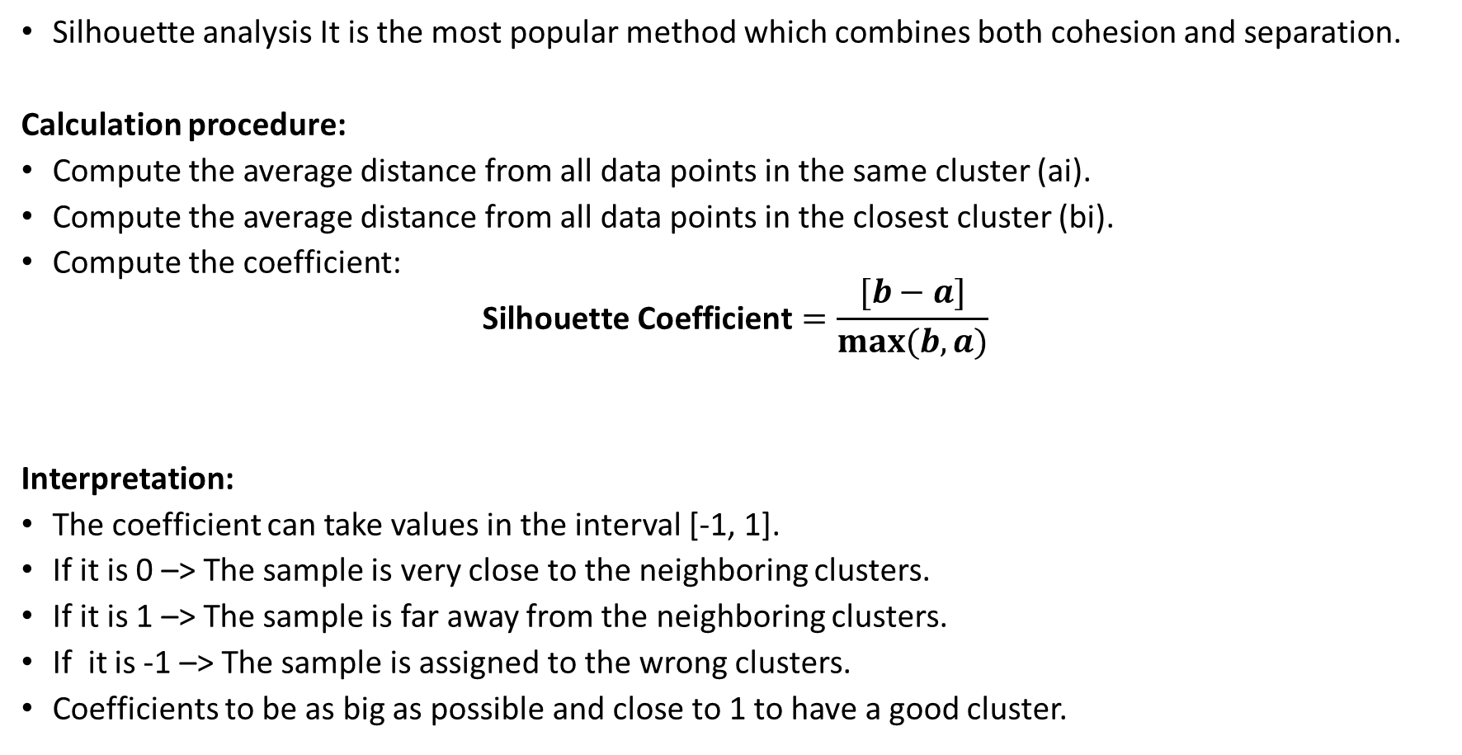
Silhouette Analysis
Silhouette analysis It is the most popular method which combines both cohesion and separation.
Calculation procedure:
Compute the average distance from all data points in the same cluster (ai).
Compute the average distance from all data points in the closest cluster (bi).
Compute the coefficient:
$$\text{Silhouette} \text{Coefficient}=\frac{[b−a]}{max⁡(b,a)}$$
Interpretation:
The coefficient can take values in the interval [-1, 1].
If it is 0 –> The sample is very close to the neighboring clusters.
If it is 1 –> The sample is far away from the neighboring clusters.
If it is -1 –> The sample is assigned to the wrong clusters.
Coefficients to be as big as possible and close to 1 to have a good cluster.

